Slide 1
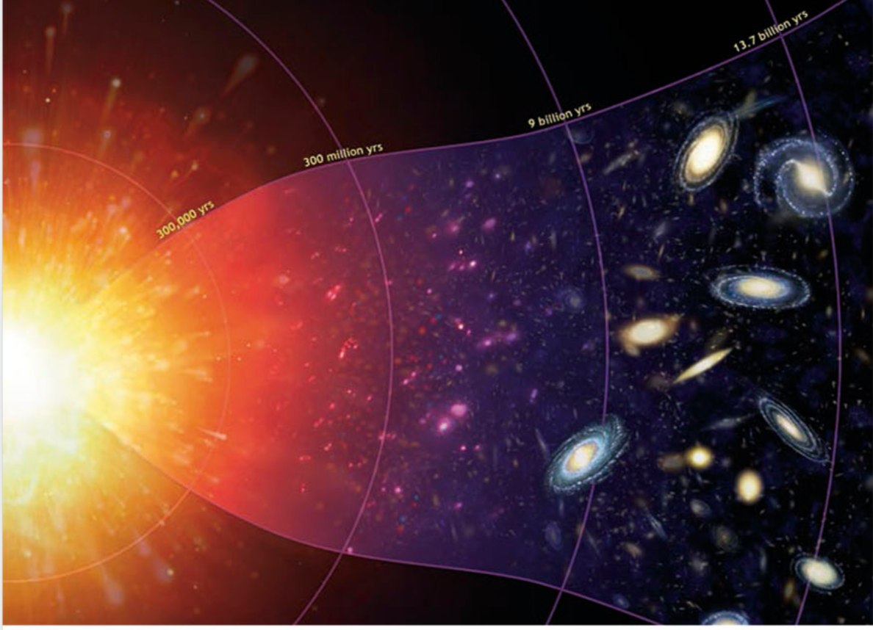
Review
The Big Bang Theory - A theory that describes how the universe developed from a small dense singularity into the massive expanded space it is today

Slide 2
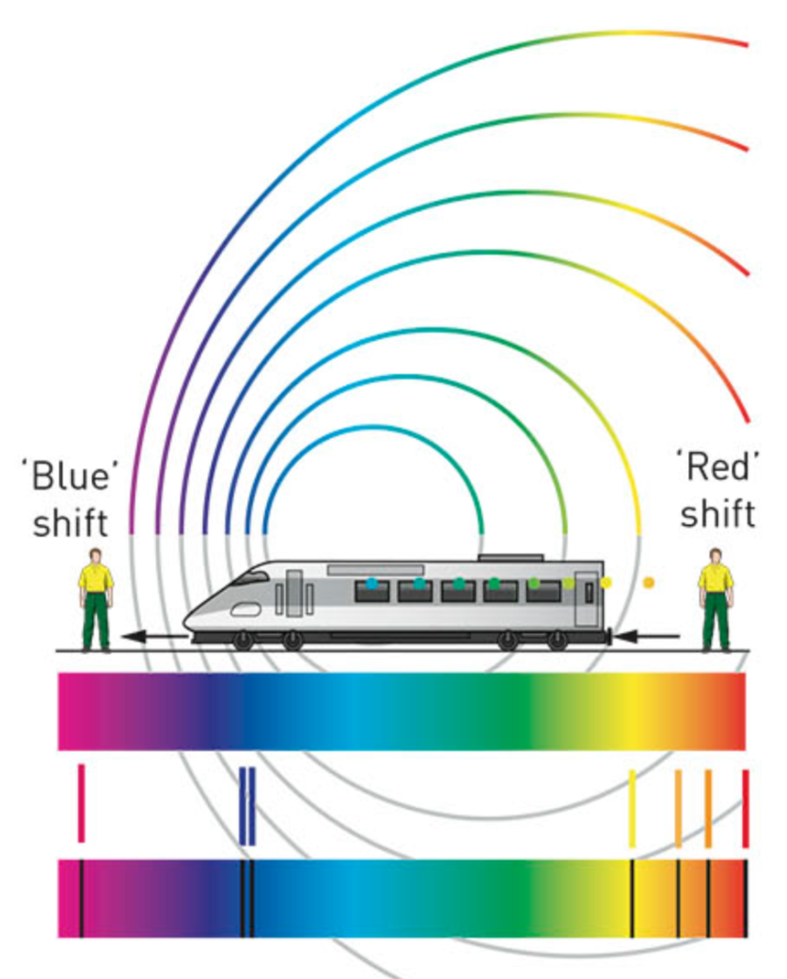
Review
Red shift - Objects that are moving away from an observer, if moving fast enough, the frequency of the light decreases, making the light appear more red
Scientists used this understanding of an expanding universe to create the big bang theory as everything is expanding away from a single point which is where the big bang is thought to have occurred

Slide 3
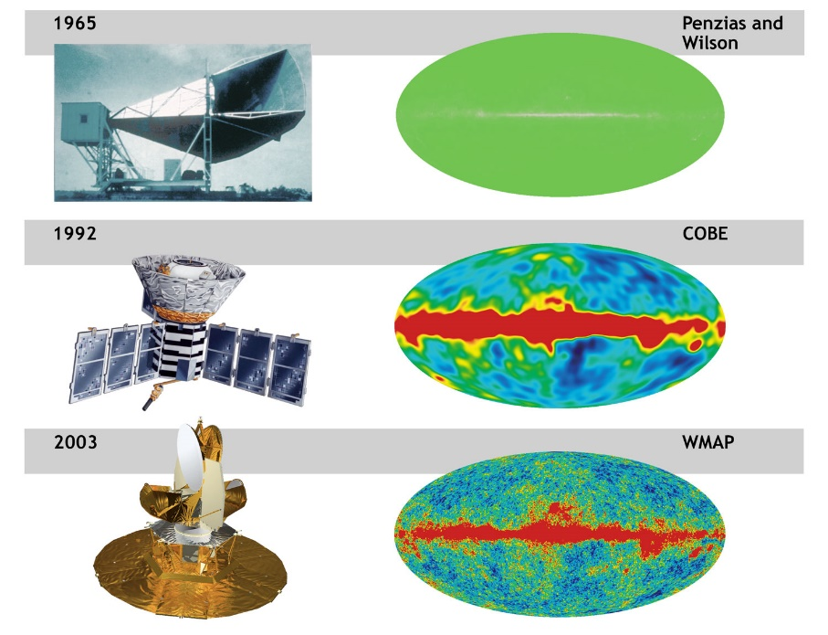
Review
Background Radiation – radiation that remains from the big bang
Mixture of elements – abundance of light elements (H, He) consistent with the Big Bang Theory
Mixture of elements – Over time energy has been converted to mass/matter so areas of the universe with low temperatures have more matter

Slide 4
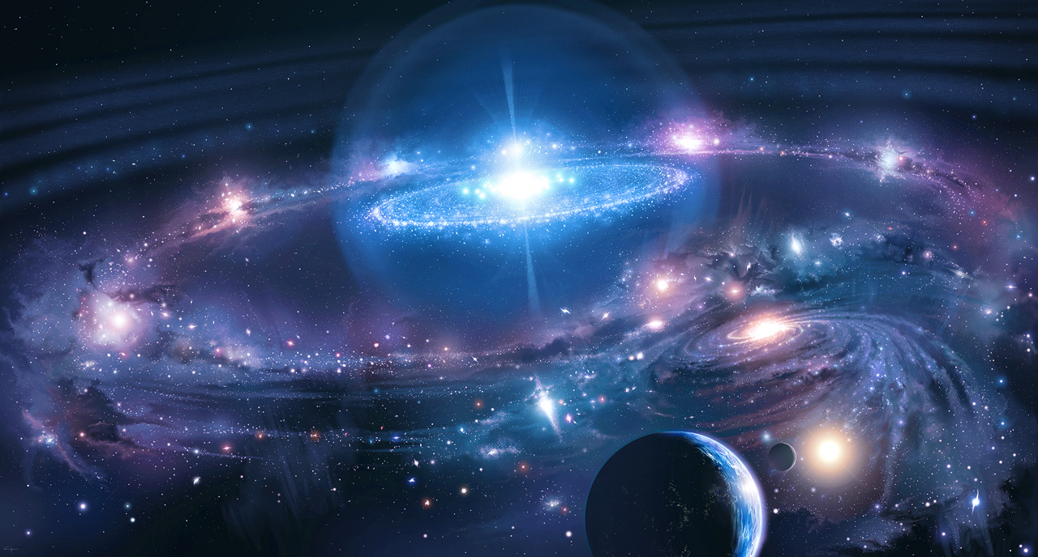
Features of the Universe

Slide 5
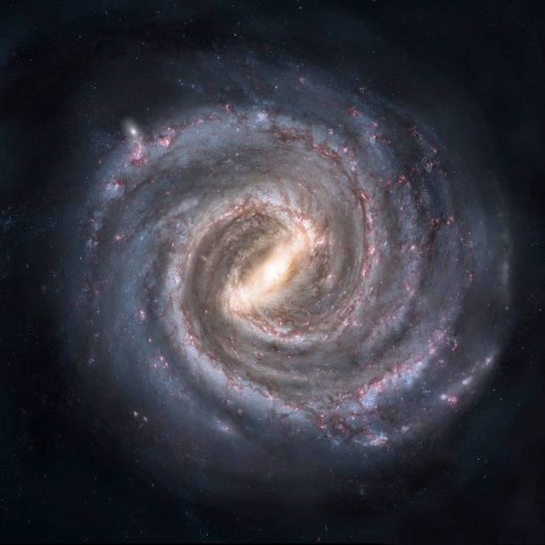
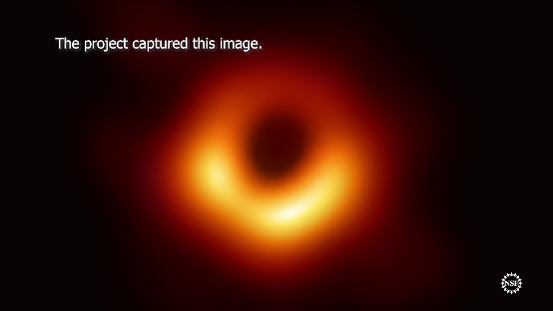
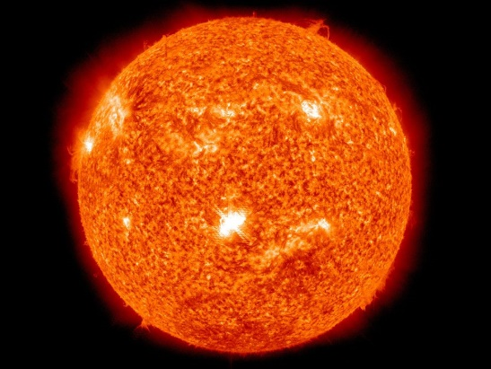
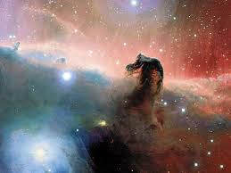
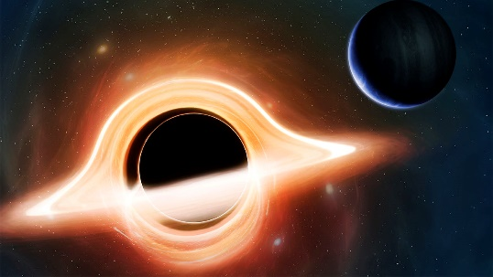
Lesson Objectives
Define the term “celestial objects”
List and describe a variety of celestial bodies
Activating prior knowledge
Think-pair-share: What can be found in space (other than nothingness)?

Slide 6
Celestial Object/body
Also referred to as an Astronomical Object/Body
A naturally occurring physical structure/object that exists within our observable universe
Planets
Nebulae
Galaxies
Asteroids
Stars
Black Holes
Comets
Moons

Slide 7
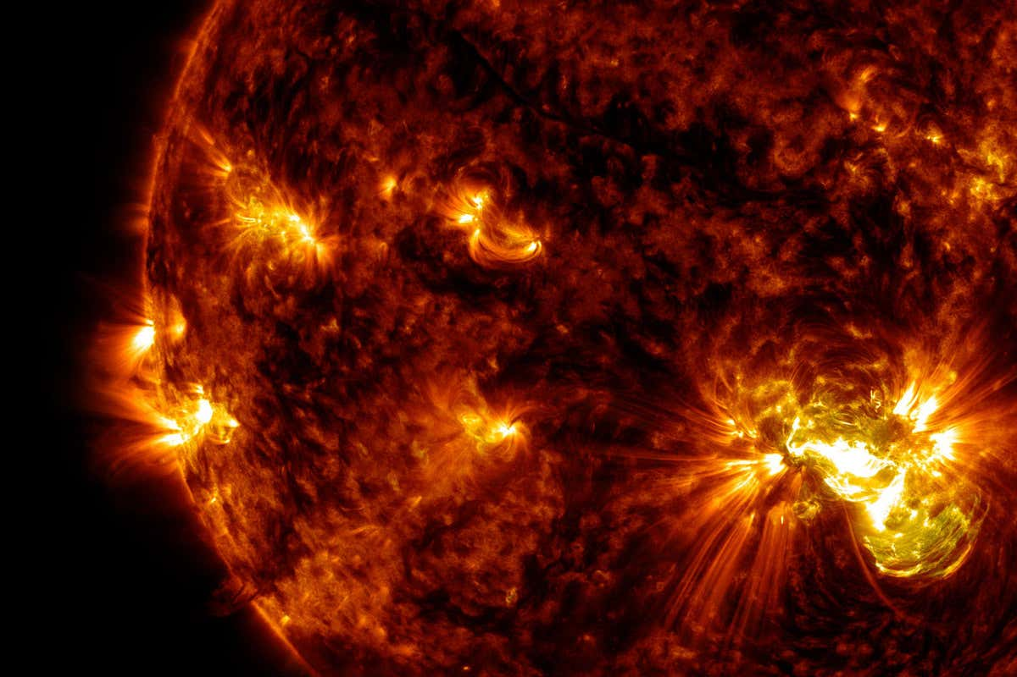
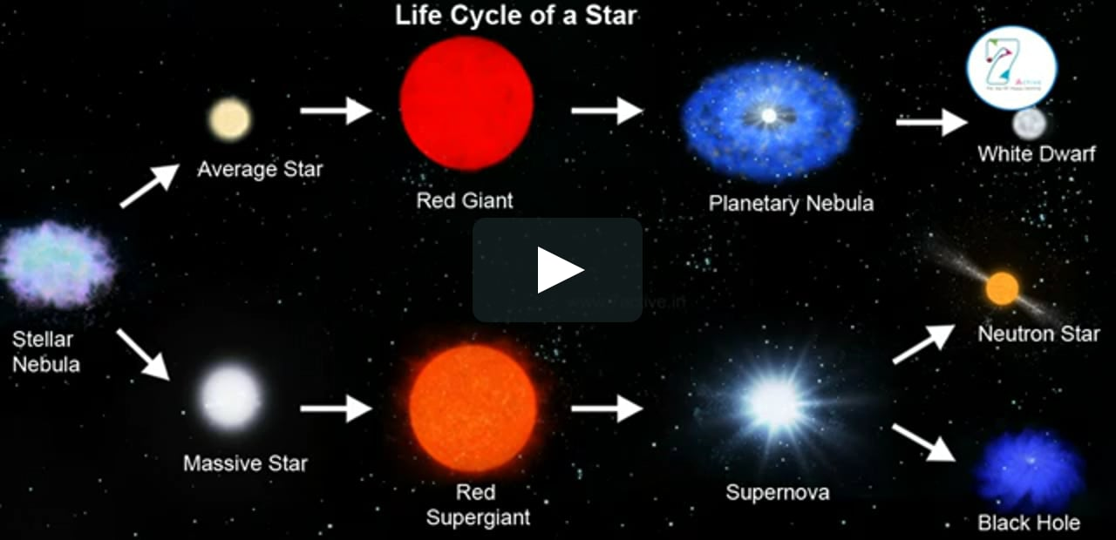
Features of the Universe
Stars
A celestial object consisting of a luminous ball of plasma held together by its own gravity
The observable universe holds approximately 1,000,000,000,000,000 billion stars.
Nearest to Earth is our Sun

Slide 8
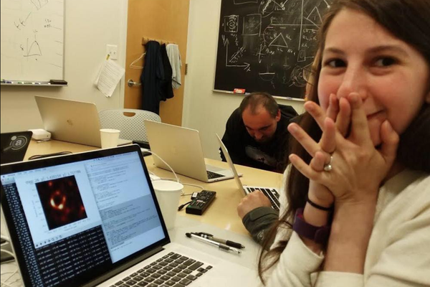
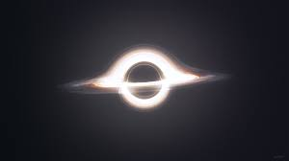
Features of the Universe
Black Hole
extremely dense, with such strong gravitational attraction that even light cannot escape
Formed when very large stars collapse at the end of their life
The closest super massive black hole is in the centre of the milky way galaxy

Slide 9
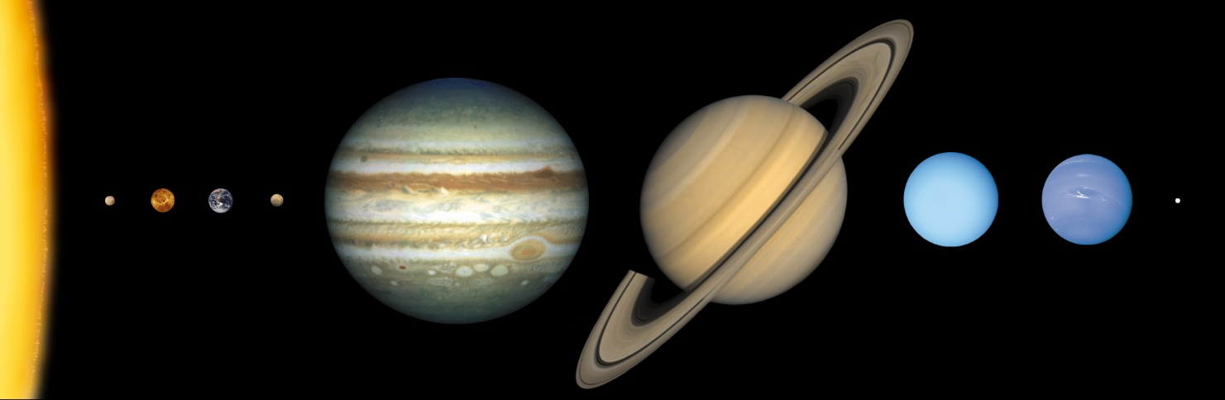
Features of the Universe
Planets
A celestial body orbiting a star that is massive enough to be rounded by its own gravity
Dwarf planets are is a celestial body orbiting a star that does not meet all criteria to be called a planet – e.g. Pluto
There are 8 planets in our solar system

Slide 10
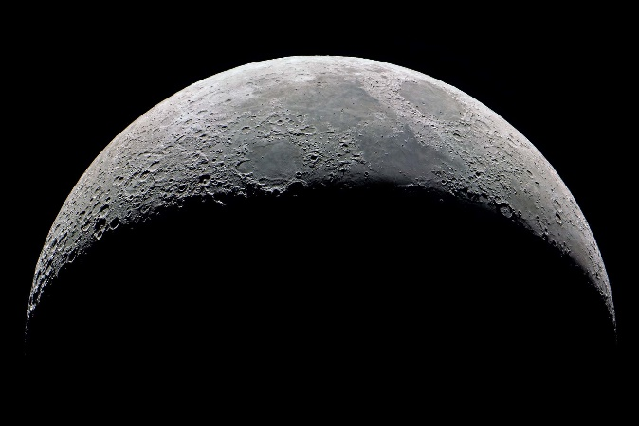
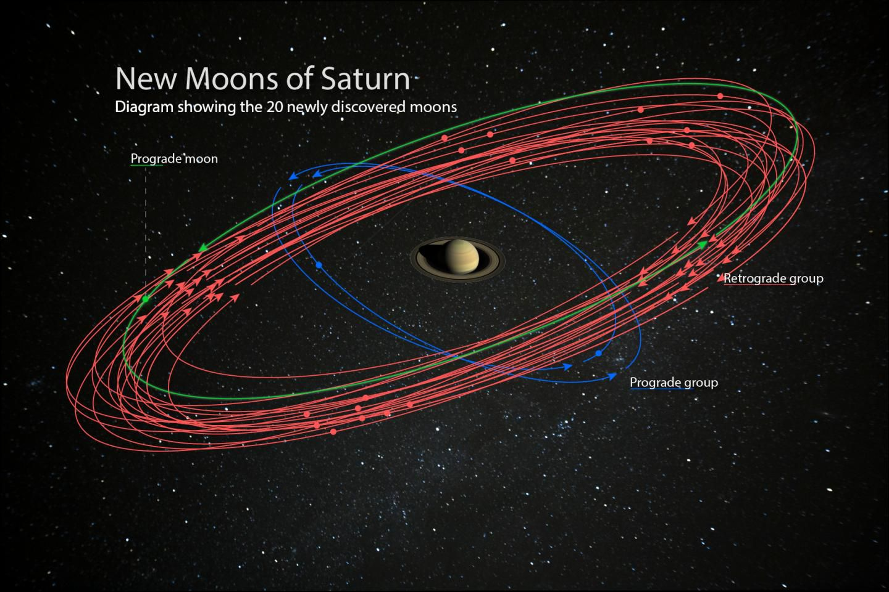
Features of the Universe
Moon
The name given to the natural satellite of a planet or dwarf planet
Fun fact: The Sea of Tranquillity is the name given to an area of the moon
Planets and their moons:
Mercury – 0
Venus – 0
Earth – 1
Mars – 2
Jupiter – 79
Saturn - 62
Uranus – 27
Neptune - 14

Slide 11
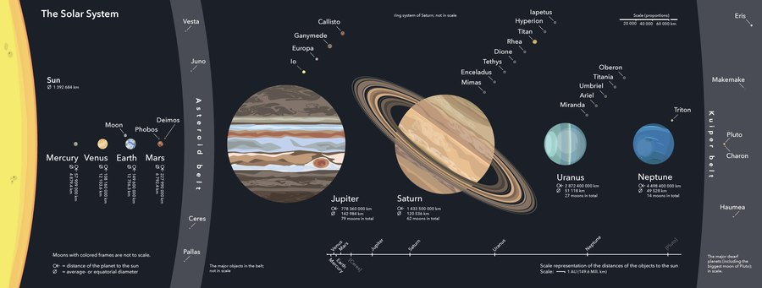
Features of the Universe
Solar system (name given to our specific planetary system)
Our sun and the objects that orbit it due to its gravitational pull
The solar system includes our sun, all of the planets, dwarf planets, moons, and millions of asteroids, comets and meteoroids
The solar system ends at an area called the Oort cloud. A shell of icy debris found outside the Kuiper Belt.

Slide 12
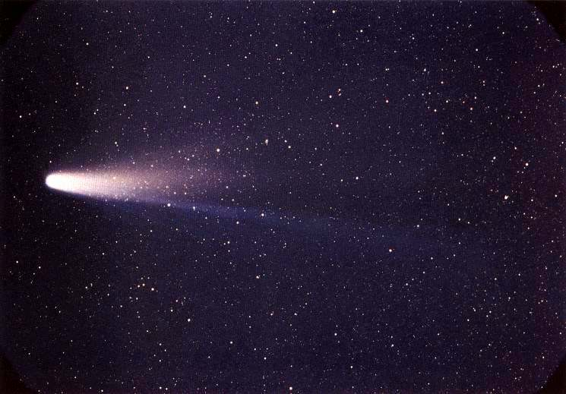
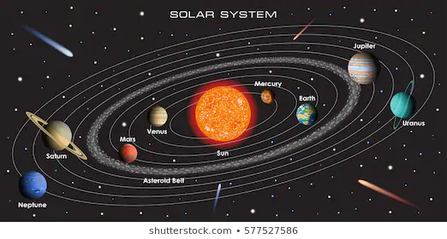
Features of the Universe
Comets
Celestial object made of ice and dust.
When near to the sun, a tail of gas and dust particles can be seen
Halley’s comet is visible to the naked eye from earth every 75 years
Asteroid
A rocky structure that is orbiting the sun however can not be called a planet/dwarf planet
When small asteroids enter the earths atmosphere we call them meteoroids

Slide 13
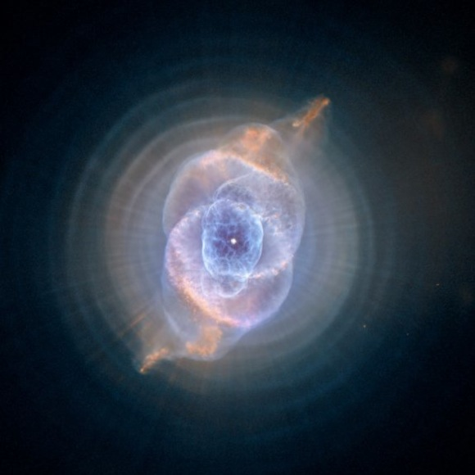
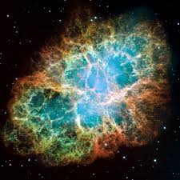
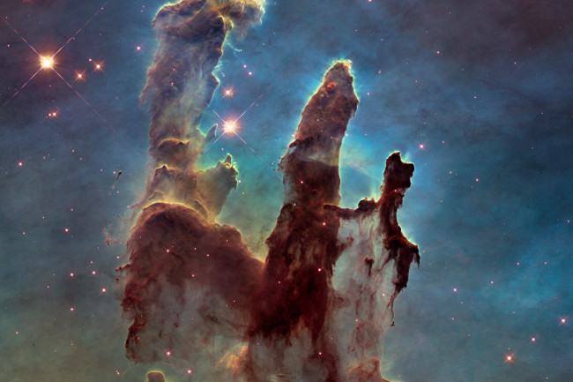
Features of the Universe
Nebula
A giant cloud of dust and gas in space
Some nebulae come from the gas and dust released when a dying star explodes (supernova)
Other nebulae are areas where new stars are beginning to form

Slide 14
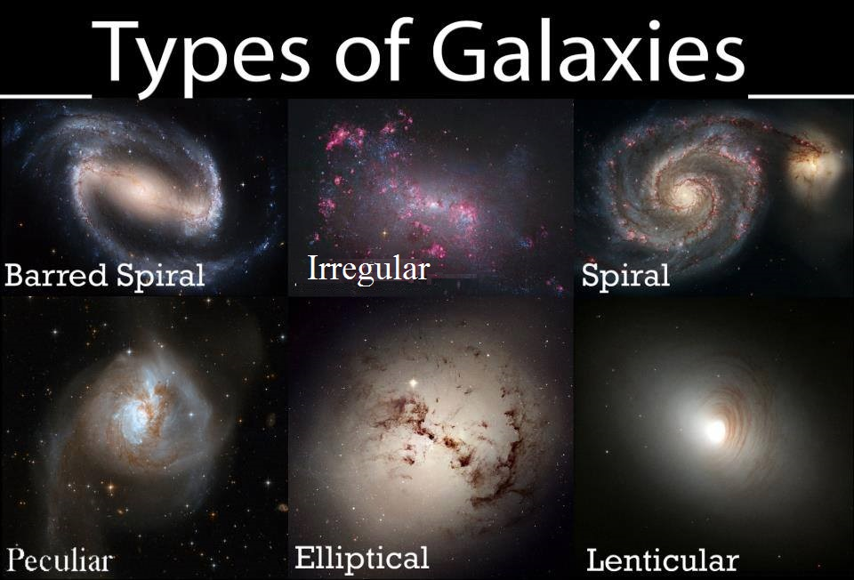
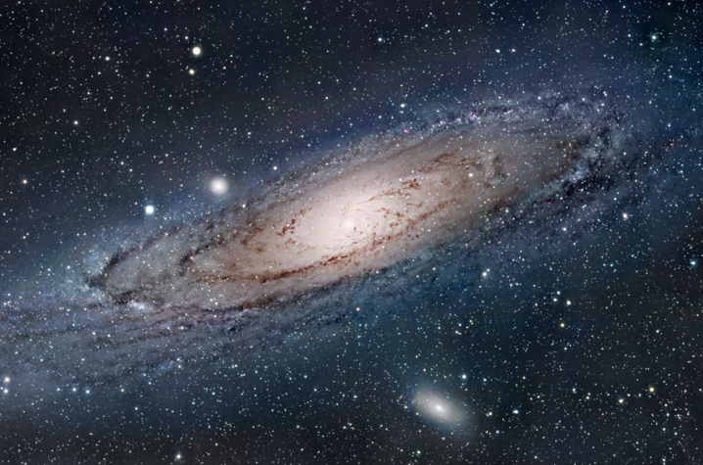
Features of the Universe
Galaxy
A huge collection of gas, dust, and billions of stars and their planetary systems
Held together by massive gravitational attraction
Most large galaxies have a supermassive black hole at their center

Slide 15
Relevance
Having an understanding of the features of the universe will allow you to gain perspective of where we sit in the universe
A basic understanding of celestial objects will help you to use the correct terminology, as well as understand the relevance of media articles
Question about this topic often come up at quiz nights!

Slide 16
Skill closure
Define the term “celestial object”
Differentiate between a planet and a moon
How does a Black Hole form, and where are they often found in the universe?
How many planets are there in the Solar system?

Slide 17
Independent Practice
In your workbook create a glossary of the key features of the universe.

